Slide 1
Graph Theory: Applications and Insights
Moulik Jain

Slide 2
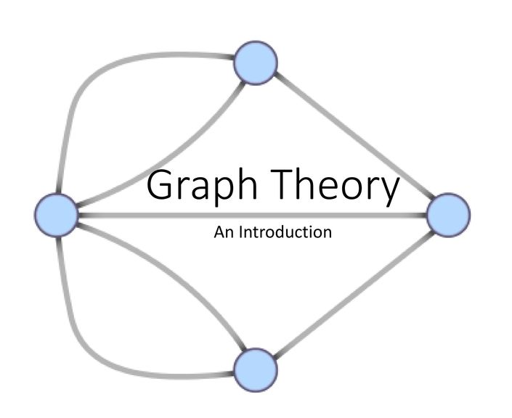
What is it?
Study of graphs as mathematical objects to solve real-world problems
Utilizes vertices and connections to simplify complex problems into organized structures
Its versatile nature in solving complex real-world problems by providing a structured framework through graphs and algorithms.

Slide 3
Fundamental of Graph Theory
Vertices and Edges:
  Graphs consist of vertices (nodes) and edges.
  Vertices represent entities, while edges denote the relationships or connections between them.
Directed or Undirected:
  Graphs can be either directed (edges have a specific direction) or undirected (edges have no direction).
  The relationships between vertices are defined by the presence or absence of edges, and the nature of these edges determines the type of graph.

Slide 4


Applications of Graph Theory
Google Maps
  Utilizing graph theory for optimal route planning
  Consideration of factors like weather conditions and traffic
Airline Scheduling
  Application of graphs in optimizing flight schedules
  Efficient resource allocation and connectivity
Social Media Marketing
  Understanding community structures through graph analysis
  Targeted marketing strategies and user engagement

Slide 5
Graph Theory Used in Google Maps
Shortest Path Algorithms:
  Google Maps employs graph theory algorithms, such as Dijkstra's or A* (A-star), to determine the shortest path between two locations on the map.
  These algorithms help find the most efficient route by considering the edges (roads) and vertices (intersections) as nodes in a graph.
Graph Representation:
  The road network is modeled as a graph, where intersections are nodes and roads are edges. This representation allows for efficient traversal and computation of routes.
Traffic Analysis:
  Real-time traffic data is incorporated into the graph model. Google Maps dynamically updates the graph, adjusting edge weights based on current traffic conditions.
  Graph-based models enable the system to reroute users in response to traffic incidents, ensuring optimal travel times.
Graph Database:
  Google Maps utilizes a graph database to store and retrieve information about road networks. This enables quick access to the graph structure and associated attributes, facilitating fast route calculations.
Spatial Indexing:
  Spatial indexing techniques, often rooted in graph theory, are employed to efficiently search and locate geographic points. This helps in quickly identifying the nearest nodes on the graph, contributing to faster map rendering and route planning.

Slide 6

Insights and Innovations
Data Visualization and Pattern Recognition:
Graph theory has empowered data scientists and analysts to visualize complex relationships in large datasets. By representing data as graphs, patterns and connections become more apparent, facilitating the identification of trends and outliers.
Algorithmic Efficiency and Optimization:
The development and application of graph algorithms have significantly improved computational efficiency in various domains. From route optimization in logistics to task scheduling in project management, graph theory has provided algorithms that help solve complex optimization problems.
Internet and Social Media Analysis:
Graph theory has been pivotal in understanding and analyzing the structure of the internet and social media networks.
Parallel Computing and Distributed Systems:
Graph theory has contributed to advancements in parallel computing and distributed systems. Parallel algorithms based on graph theory principles enable efficient processing of large-scale data across multiple computing nodes.

Slide 7
Challenges and Limitations
Challenges Faced
  Addressing difficulties when applying graph theory in different contexts
  Overcoming complexities in certain problem domains
Limitations
  Graphs inherently represent discrete relationships between nodes and edges, making them less suitable for modeling continuous data being changed over time.

Slide 8
Summary
Structural Representation and Analysis:
  Graph theory provides a powerful framework for representing and analyzing the relationships between interconnected entities. Using nodes and edges, it models diverse systems such as social networks, biological pathways, and transportation networks, allowing researchers to study structural properties and uncover underlying patterns.
Algorithmic Solutions for Optimization:
  Graph theory offers a rich set of algorithms that address optimization challenges in various fields. From finding the shortest path in transportation networks to optimizing resource allocation in project management, these algorithms enhance efficiency and provide solutions to complex problems, contributing to advancements in logistics, scheduling, and resource management.
Cross-Disciplinary Applications:
  The versatility of graph theory transcends traditional boundaries, finding applications in diverse disciplines. Its cross-disciplinary impact underscores its importance as a fundamental tool for understanding and solving complex problems in a wide range of domains.

Slide 9
References
Bondy, J. A., and U. S. R. Murty. Graph Theory with Applications. American Mathematical Society, 2008.
Diestel, R. Graph Theory. Springer, 2017.
Barabási, Albert-László. Linked: The New Science of Networks. Perseus Publishing, 2002.
Sedgewick, Robert, and Kevin Wayne. Algorithms. Addison-Wesley, 2011.
Newman, M. E. J. Networks: An Introduction. Oxford University Press, 2018.

